Slide 1
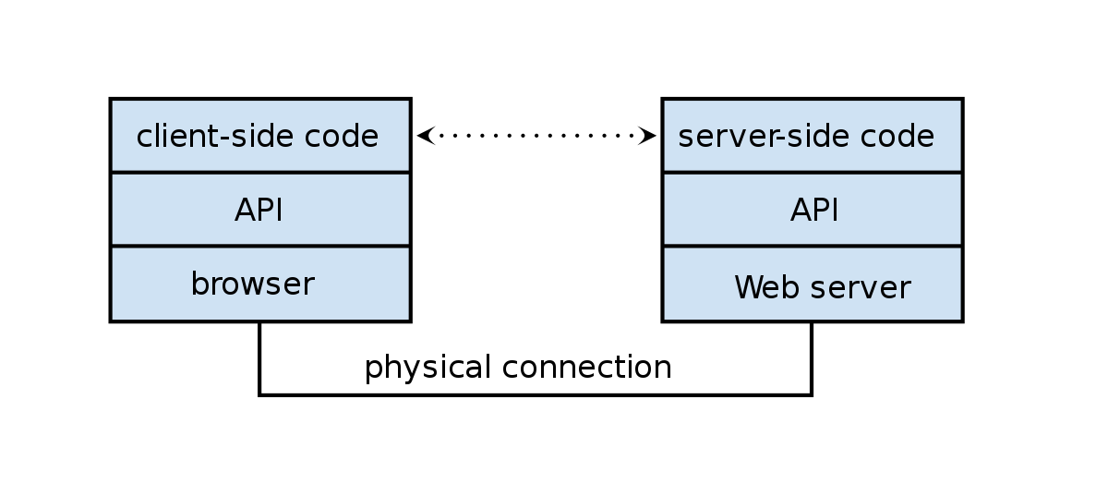
Express Middleware
Frank Walsh

Slide 2
Agenda
Express Middleware
Routing in Express
The Request and Response object

Slide 3
Express Middleware
Notes:
DEMO!!!

Slide 4
Express Middleware stack
The HTTP request (also the response) passes through a pipeline/stack of middleware functions
Some task is executed at each stage:
Express App
HTTP Request
Authenticate
Parse Body
Main Task
http response
Notes:
check request is authenticated,
parse body
“inject” as an extra param in the request

Slide 5
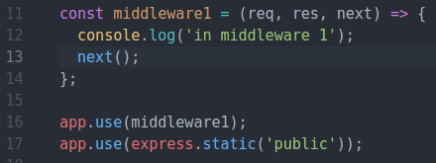
Express Middleware
Middleware functions have access to the request object (req), the response object (res), and the next() middleware function in an express application’s request-response cycle.
Your express app will have a ‘stack’ of middleware functions that can
Execute any code.
Make changes to the request and the response objects.
End the request-response cycle.
Call the next middleware function in the stack.
Notes:
DEMO! Simple Middle =ware

Slide 6

Express Middleware Types
Router level
Application level (app.use(…))
Every request is handled
Often 3rd Party (Authentication middleware)
Error handlers
Takes error as first parameter (err,req,res,next) => { …. }
Baked in
express.json()

Slide 7

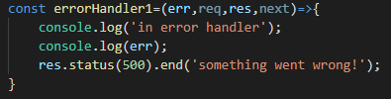
Middleware Functions
App level and 3rd party middleware receive 3 arguments
Error Handling middleware receive 4 arguments(error first)

Slide 8
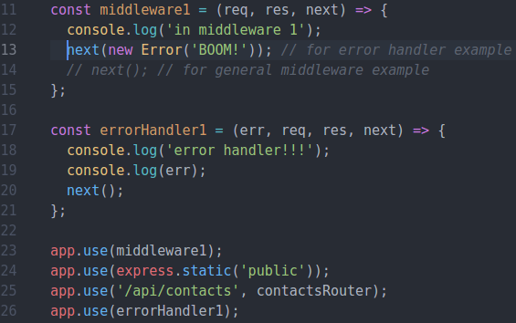
Express Middleware – Error Middleware
Raise error and pass on to next error handling middleware in middleware stack
NOTE: Middleware stack processed in the order it appears in script.
Notes:
DEMO ERROR MIDDLEWARE

Slide 9
Routing in Express: Routing Middleware

Slide 10
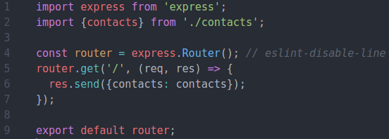
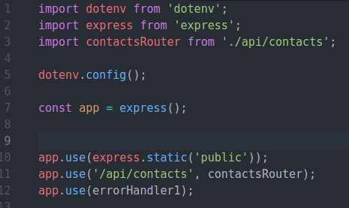
Express Routers
/api/contacts/index.js (contacts router)
Exports router instance
Can have several "routers" to implement your APIs.
Router can have its own routing and middleware
Good for multiple APIs/ versioning
Still uses the application level middleware of express app.
/index.js (express app)
Mount router to URL.
/api/contacts becomes Base Route for router
Notes:
DEMO GET CONTACTS

Slide 11

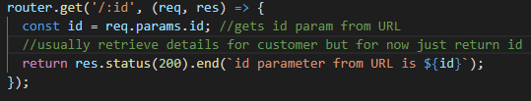

Express Routers – Parameters
Route parameters are named URL segments that capture the values specified at their position in the URL.
The req.params object contains the parameter values, with the name of the route parameter specified in the path as their respective keys.
Notes:
DEMO GET CONTACT

Slide 12

Express Request Object
The req object represents the HTTP request.
by convention, the object is referred to as 'req', Response is 'res'
Can use it to access the request query string, parameters, body, HTTP headers.
Example:
Parameterised URL. Access using req.params.id
Notes:
Req.Param is an abstraction layer for picking up information about a request – it automatically searches:
Query strings
Posted form values
Route values
And will let you pick from what’s available
12

Slide 13
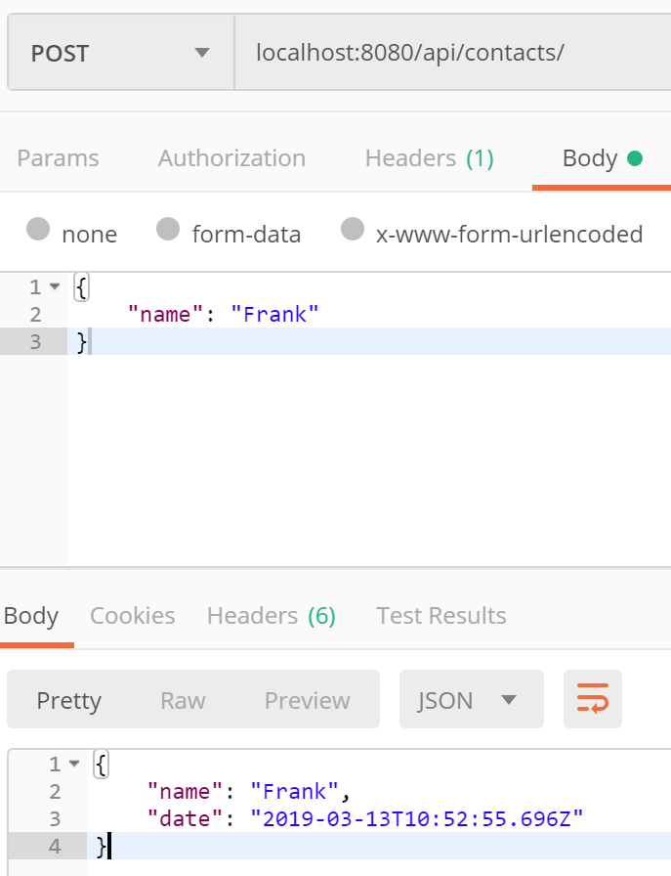

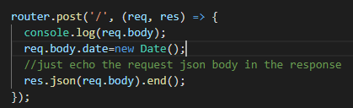
Express Request Object
req.body
Contains data submitted in the request body. ​
Need body-parsing middleware such as express.json().​
This example shows how to use body-parsing middleware to populate req.body.​
index.js code snip (express app)
Testing using Postman
/api/contacts/index.js code snip (contactsRouter)
Notes:
DEMO!!

Slide 14
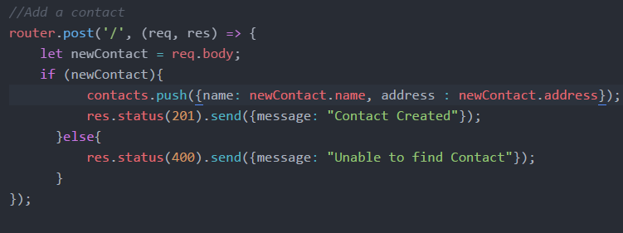
Express Response Object
The res object represents the HTTP response that an Express app sends when it gets an HTTP request.

Slide 15

Express Response Properties
res.send([body])
The body parameter can be a String, an object, or an Array.
For example:

Slide 16
Response Properties
res.json([body])
actually calls res.send(), but before that it:
respects the json spaces and json replacer app setting
ensures the response will have utf8 charset and application/json content-type res.json({ user: 'tobi' })
res.status(500).json({ error: 'message' })

Slide 17
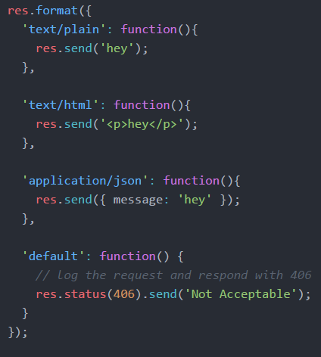
Response Properties
res.format(object)
Performs content-negotiation on the Accept HTTP header on the request object
Addresses "multiple representations" REST principle

Slide 18
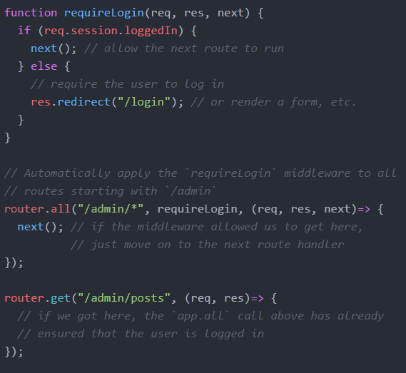
Filters
If you want to authenticate for access to resources you can use multiple callbacks built into express routing.
Multiple Callbacks

Slide 19
Summary: Express Middleware
Express is a Routing and Middleware framework.
You've seen the routing in the previous lab
Middleware functions have access to the Request,Response and the next() function
The next function calls the next middleware function.
Use middleware to
Change the request/response
End the request/response cycle
Call the next middleware in the stack.
If middleware does not call next() or return, express will just hang
Can be an issue with promises but can be resolved

Slide 20
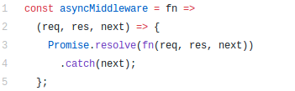
Middleware with Async await/promises
Express will not detect rejected promise automatically
Error handling middleware will not be called – causes app to hang.
Couple of ways to address this
Use try/catch in each async function/promise (lots of repetitive code)
Use a helper function that wraps our express routes to handle rejected promises.
Handy: someone has published a NPM package… npm install --save express-async-handler

Slide 21
Further Reference
ExpressJS.com - Official Express Homepage
Node and Express Tutorial

